Slide 1
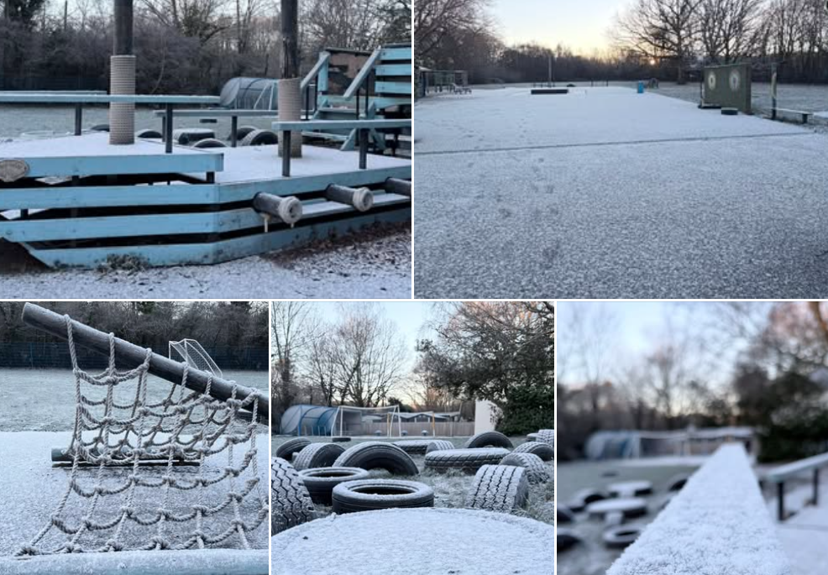
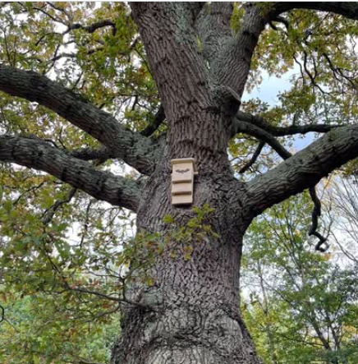
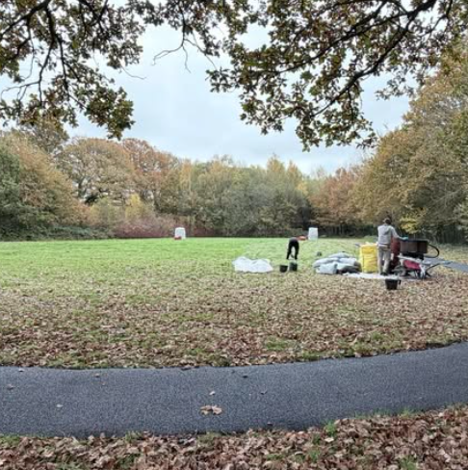
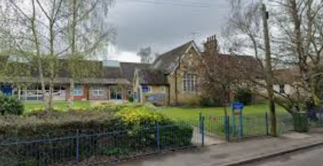
Using our outdoor space

Slide 2

The life of a child is changing:
Average screen time per day 5 hours
Average outdoor play time per week 5 hours
Percentage of UK children who only play outdoor with other children at school 56%

Slide 3
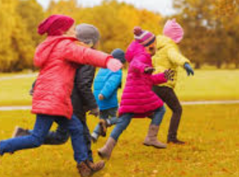

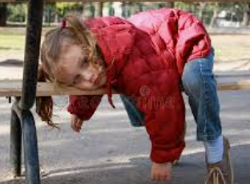
Children spend 20% of their time in school outside at playtime - equivalent to 1.4 years of primary school
But what are they actually doing?

Slide 4
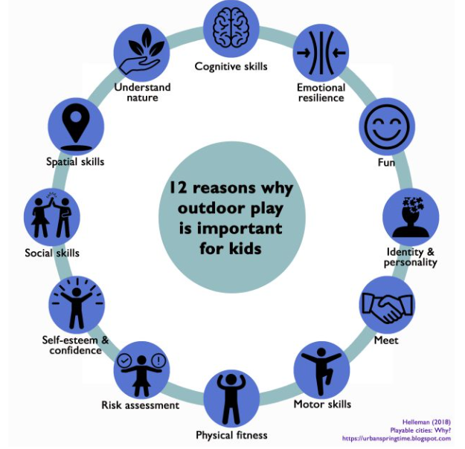

Quality unstructured outdoor play has lots of benefits

Slide 5

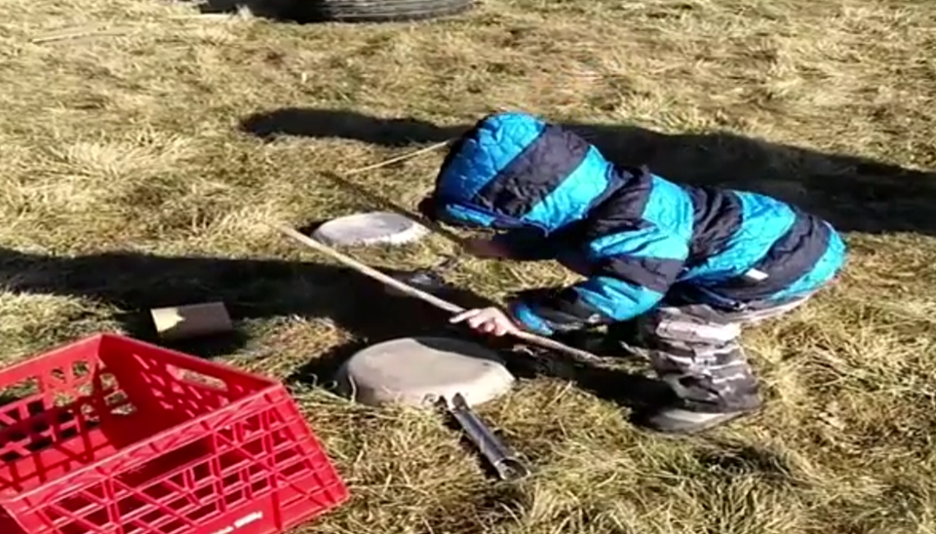
At Marchwood CofE infant school we are so lucky to have fantastic grounds - BUT we want children to use them as much as possible

Slide 6
I Asked the children what they liked / disliked about play/lunch times
Liked:
Playing chase
Going on the climbing frame
The Galleon
The trim trail
Disliked:
When we can’t go outside
When it’s only YR on the galleon
When we are not allowed to play with sticks
Losing the balls
Not having anything to do

Slide 7
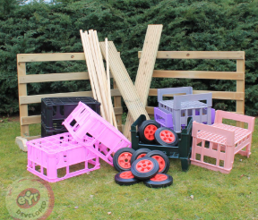
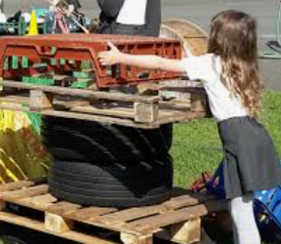
So how do we achieve a stimulating play and break where children are learning?
Loose parts
Crates
Suitcases
Prams
Fabric
Pipes / guttering
Steering wheels
Small ladders
Jugs
Pallets
Traffic cones
tarp…….

Slide 8
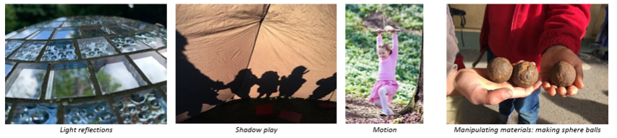
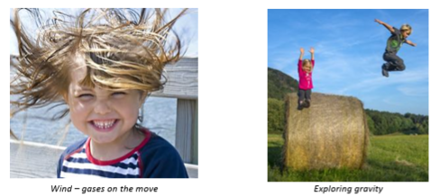
Just some of the things they can learn through loose parts

Slide 9
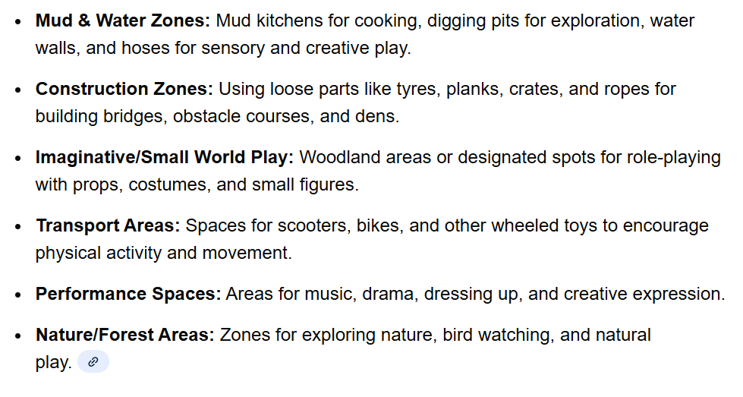

Slide 10
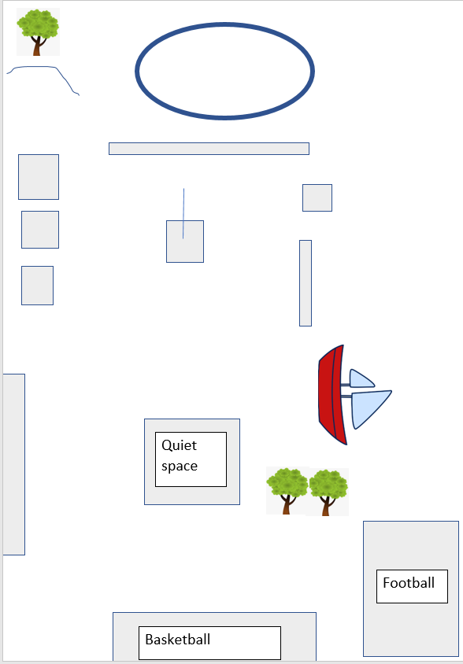
Transport
Zone 4
Forest / nature area
Zone 5
Zone 6
Small play
Quiet space
Construction
Zone 3
Mud and water
Zone 1
Performance and materials
Zone 2
Sand and Tyres

Slide 11
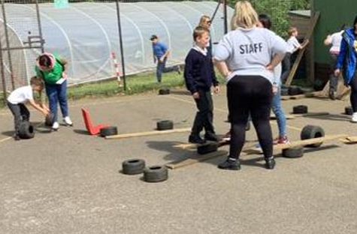
But what about risks?
By risky play, we don’t mean engaging in dangerous and reckless behaviour or playing in hazardous areas.
Rather, risky play refers to play that involves thrilling, exciting, physically challenging activities like climbing, jumping, balancing, or rough and tumble play, as well as hiding or seclusion from the constant surveillance of adults.
The risk part is really more about how adults feel about it and their desire to keep children safe.
All our risk assessments balance risk and benefits
By taking away ALL risk - we take away the chance to explore
And challenge.

Slide 12
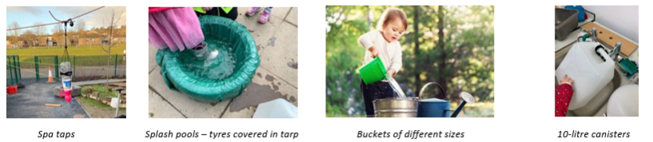
How much supervision do they need?
Very little.
Child thrive if left to learn independently.
Adults are there to assist and suggest but the main learning comes from the freedom to explore

Slide 13
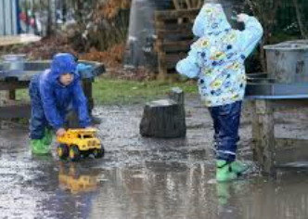
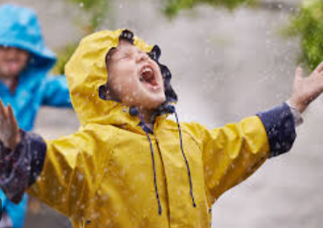
What about the weather?
We believe that there is no such thing as bad weather - just bad clothing!
Every child will need:
Wellies (if you have extra can you donate some?)
A waterproof coat
An extra set of clothing because there is a chance they will get wet and dirty
A hat - wooly or summer
Layers to keep them warm

Slide 14
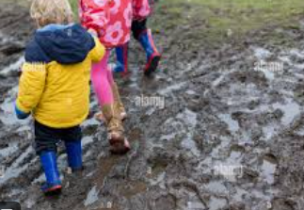
What can you learn from a muddle puddle?
Weather
Sinking and floating
Size / depth / temperature / colour / shape / number
Building bridges
Cause and effect
Water cycle
Time
The list is endless…….

Slide 15
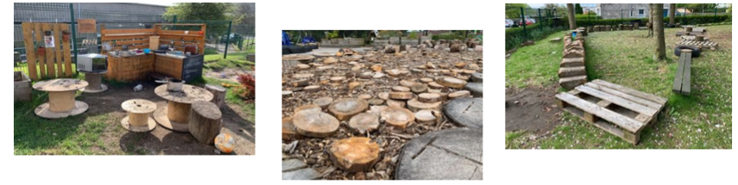
What do we need from you?
Trust - we will never put your child in harms way and we want the best for them at all times.
Spare clothes - we will be getting wet and dirty.
Donations - anything you can donate for our loose parts.
Wellies
Ideas

