Slide 1
Behavioural Difficulties in Children and Young People – A Workshop for Parents
Mary Gill and Kate Munday

Slide 2
Session Overview
This workshop will explore challenging behaviours in children and young people. We will cover:
What defines behavioral difficulties
How young people with behavioural difficulties present
Common challenges
Practical strategies to support

Slide 3
Session Aims
To provide parents and carers with knowledge and practical strategies to support children and young people who are experiencing behavioural difficulties.

Slide 4

What would you like to get out of today’s session?

Slide 5
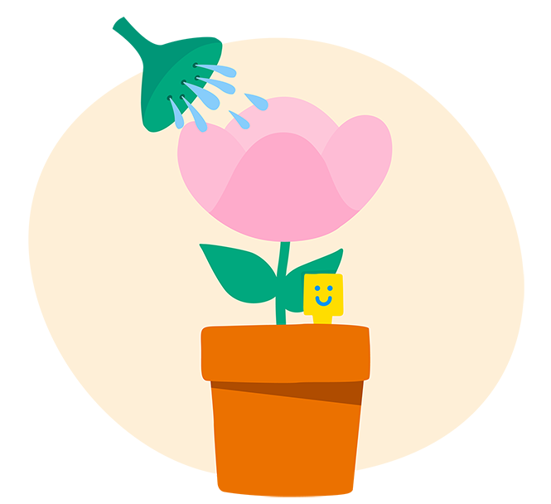
Take Care of
Yourself

Slide 6

Please Remember
Confidentiality
Empathy and respect
Nonjudgmental

Slide 7
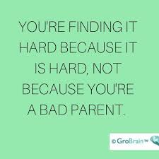
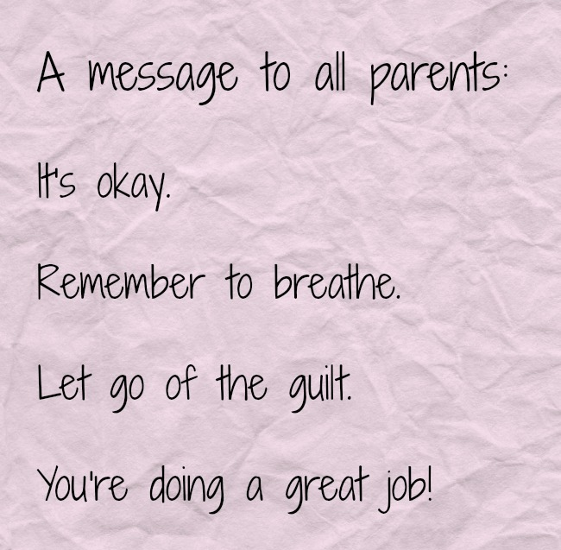
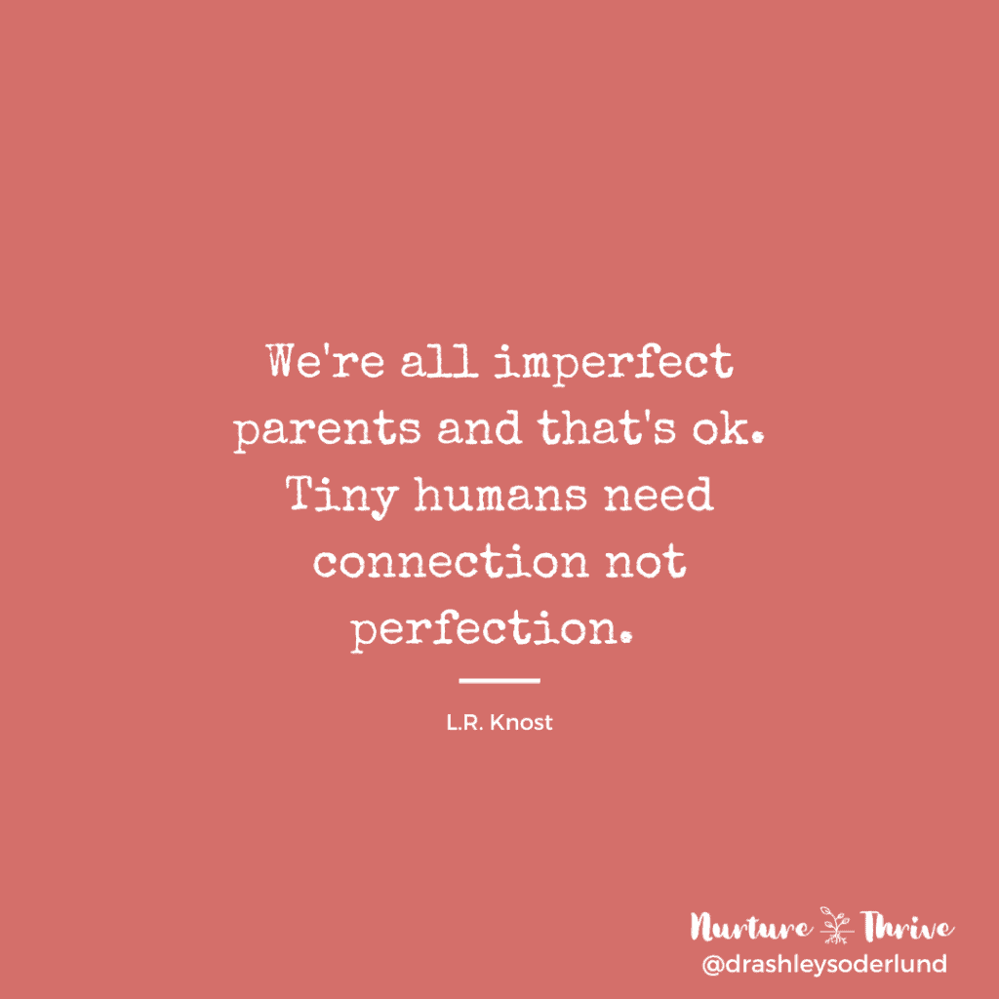

Slide 8
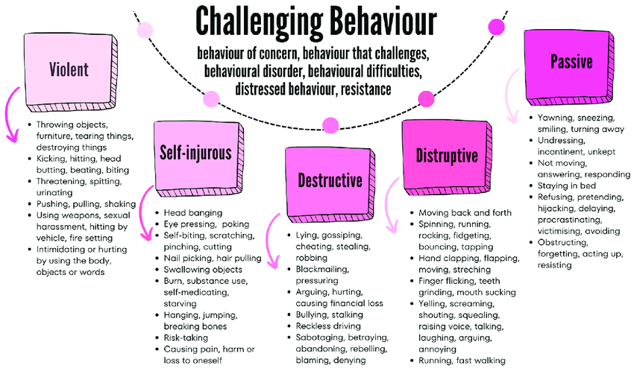
What do we mean by challenging behaviour?
(Goldschmied & Holyoake, 2024)
Notes:
Goldschmied, A.Z. and Holyoake, D.-D. (2024) ‘Resisting to exist and the subtle invisible protest: Six solution focused tactics about challenging behaviour’, Adolescents, 4(3), pp. 426–439. doi:10.3390/adolescents4030030.

Slide 9

No child is trying to be a problem,
they are trying to solve a problem!

Slide 10
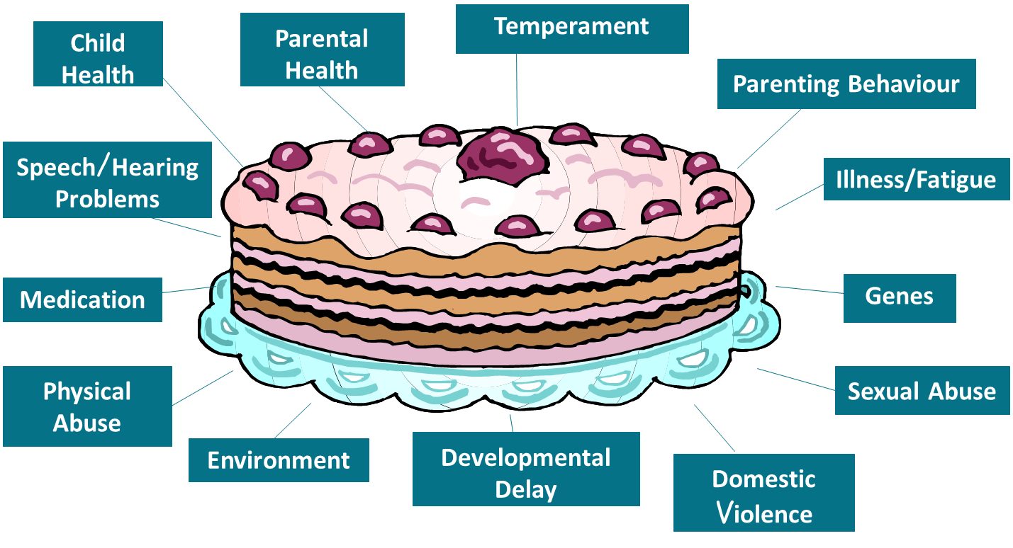

Slide 11
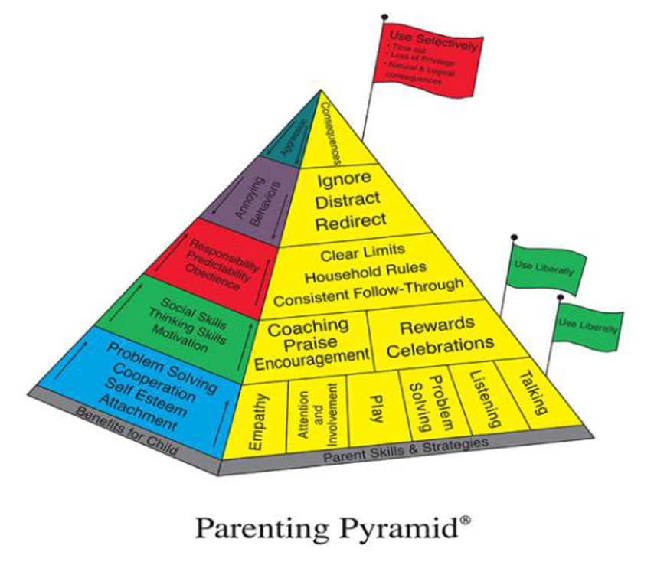

Slide 12

Positive
Play
Praise,
Talk
Smile
Listen
Positive touch
Attends
Negative
Shout
Telling off
Smack
Criticise
Swear
Negative verbal input
(name calling/complaining).
Notes:
Children are biologically programmed to gain attention from others-children relate attention seeking to safety and survival. By attention seeking, the care giver increases the bond and is more likely to protect from predators. Attention also helps build positive self-image and helps child feel secure and safe.
Children will work for attention from others, especially parents, whether it is positive or negative in nature. If children do not receive positive attention, then they will strive for negative attention through misbehaviour as that is better than none at all. Therefore, if we want to promote more prosocial behaviours, we need to give the child attention when they are exhibiting those behaviours. This can include attending to the child's behaviour.
TIP: When attending to a child's behaviour, imagine you are a sports commentator describing every movement on the football pitch to somebody listening in the radio.
Use silent question, verbal answer: "what is the child doing now?"
Describe what the child is doing
Describe how the child is looking
Describe where the child is
Describe desirable behaviour
3 main strategies:
Reinforce desired behaviour
Withhold reinforcement for undesired behaviour
Use modelling, rehearsal and feedback to improve parenting skills
2 key rules:
Reinforced behaviour is more likely to occur
The child's behaviour is orientated to gain attention from others

Slide 13
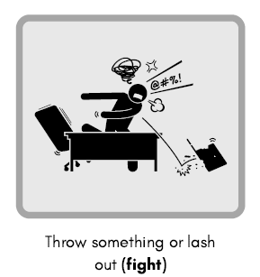
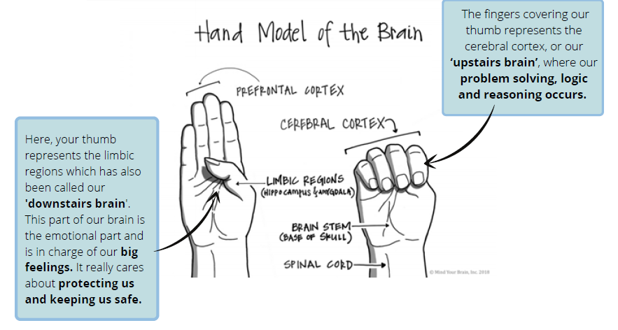
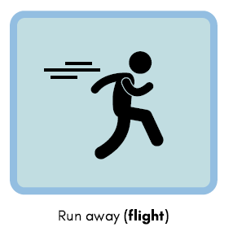
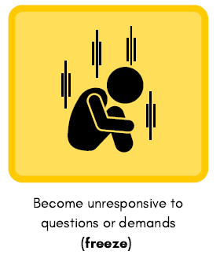
Upstairs and Downstairs Brain (Siegel, 2010)
Notes:
https://youtu.be/Kx7PCzg0CGE

Slide 14
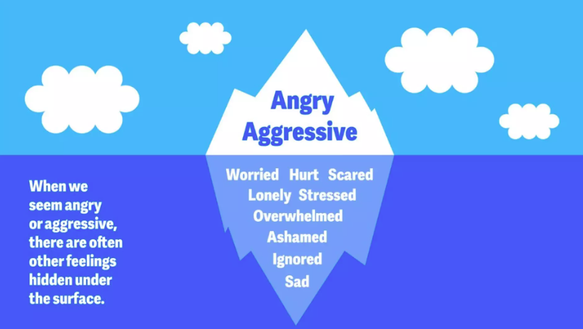
Behaviour Iceberg
Notes:
Fig. taken from YoungMinds Challenging Behaviour | Parents' Guide To Support | YoungMinds

Slide 15
Fight response
Why are they behaving like this?
Upset
Overwhelm
Young Person
Frustration
Confusion
Fear
Sadness
Adult
I can't cope
Everyone hates me
Shout
Reprimand
Ignore

Slide 16
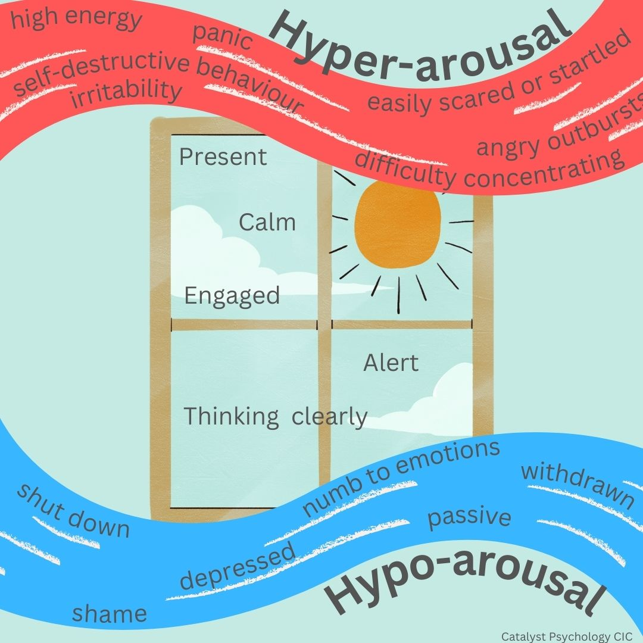
The Window of Tolerance (Siegel, 1999)
.

Slide 17
The ABC of Behaviour
Antecedent
Events or interactions that happen before the behaviour occurs (inc. triggers)
Behaviour
Behaviour or sequence which has occurred
Consequence
Events or interactions which happen after/because of the behaviour

Slide 18
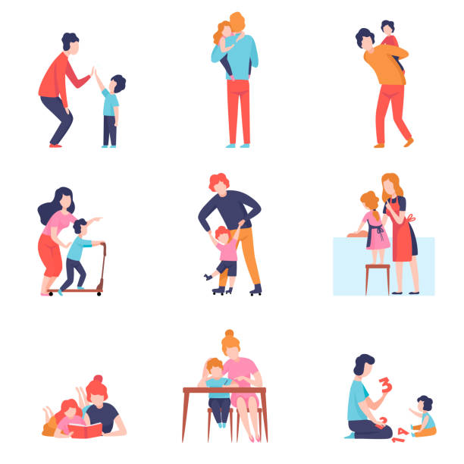
Evidence Based Strategies
1:1 time
Use toys/activities that are not competitive and do not have a ‘right or wrong’ way to use them.
Give the child undivided attention.
Allow the child to choose the activity.
Follow the child’s lead.
Show interest/ amazement/empathy.
Match their pace
Listen and repeat back
Be polite and ask to play

Slide 19


Tells the child which behaviours to repeat to gain positive attention.
Increases self-esteem
Make your praise specific
Give praise as close to the good behaviour as you can

Slide 20

Evidence based Strategies
Rewards:
How can I identify behaviours to reward?
Identify challenging behaviour - what would the alternative behaviour look like
How can we support them to get back to their green zone? Can we reward a regulation support behaviours?
What will the rewards be?
Get the child’s buy-in, involve them in choosing rewards, what motivates them?
Achievable
At least one quick win, to keep the child engaged
Specific
Child needs to know exactly which behaviour you’re looking for
Non-punitive
Earnt rewards are not taken away
Notes:
How can I identify behaviours to reward?
Identify challenging behaviour – Helpful to understand the CYP’s triggers into the amber and red zones
What would the alternative behaviour look like – what is the direct opposite of the challenging behaviour? – could this be a behaviour to reward?
Using zones of regulation, What supports the CYP to move back to green? - can we reward one of those regulation support behaviours?
Quick win – what might they be doing ok at, but not consistent with at the moment – add this as a behaviour to reward.
Working document to review every week or so – with the CYP
Habituated behaviours would then be rewarded with praise and new supports for other challenging behaviours will be added

Slide 21
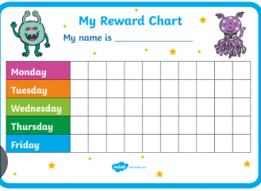
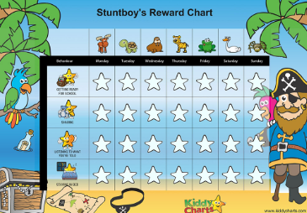
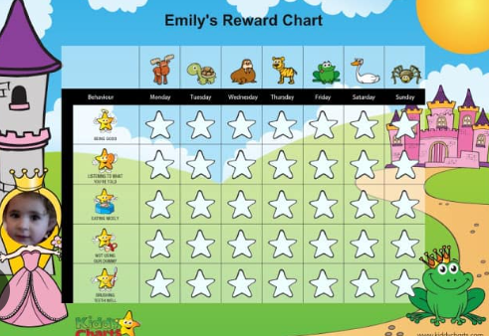
Evidence based Strategies
Reward charts:
engaging specific to child’s interests,
lists specific behaviour to reward,
can pair reward with behaviour,
How many times does it need to be seen in order to get reward?
How can you make it easy for yourself to observe the behaviour?
No reward unless behaviour is seen ‘I promise I’ll do it later…’

Slide 22
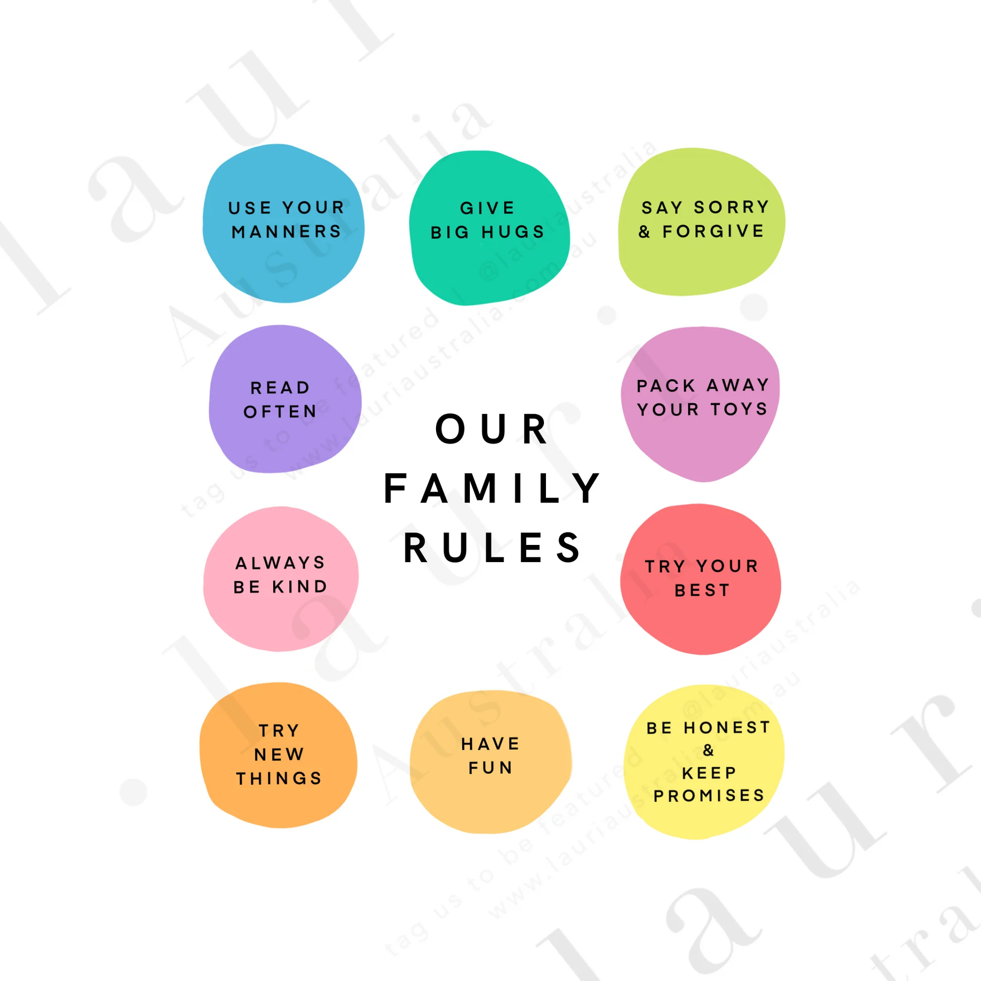
Evidence Based Strategies
Clear Commands and Rules
Teach the difference between appropriate and inappropriate behaviour
Encourage children to make choices about their behaviour
Learn from mistakes
Consistent limits help a child feel calm and safe

Slide 23




DEAR
Describe: When you throw things and shout when your angry, it makes it hard to help you.
Express: I can feel sad because I want to help you, but I can’t understand you.
Assert: I need you to use your words when you are angry or to go to your safe space to calm down a bit.
Reinforce: If you talk to me without shouting, I can then help, and we sort it out which would make us both feel better.
Notes:
Avoid- Why, How, Would
DEAR method in self regulation
How the DEAR method helps with self-regulation:
D - Describe: This encourages stating the facts of a situation objectively, avoiding judgment or blame. This helps approach challenging interactions with clarity, minimizing the chance of being swept away by emotions or making assumptions about intentions.
E - Express: This step focuses on expressing feelings and opinions about the situation using "I" statements. For example, instead of saying, "You make me angry," it would be "I feel angry when...". This helps to own feelings and communicate them effectively without causing defensiveness.
A - Assert: Here, it is important to clearly state what you want or need or firmly say "no" when necessary. This involves being direct and assertive, rather than passive or aggressive, and communicating needs respectfully.
R - Reinforce: This step is about highlighting the positive consequences of getting needs met or the positive outcomes for the other person if they agree to your request. This reinforces the request in a positive way, encouraging the other person to be more receptive to what you're asking for.
By practicing the DEAR method, individuals are actively engaging in self-regulation by:
Managing Emotions: Learning to identify and express emotions constructively, rather than reacting impulsively or suppressively.
Improving Communication: Developing clearer and more effective communication skills, reducing misinterpretations and conflicts.
Setting Boundaries: Gaining the ability to assert needs and set healthy boundaries in relationships, protecting well-being.
Fostering Self-Respect: Learning to advocate for yourself and stand up for values, which builds self-confidence and self-respect

Slide 24

Some things to remember…
Strike while the iron’s cold
Rule of one
“Auto-pilot statements”
Offer a way out
Quite tone / non-threatening body-language

Slide 25
Consistency is Key
Say what you mean
and mean what you say.

Slide 26
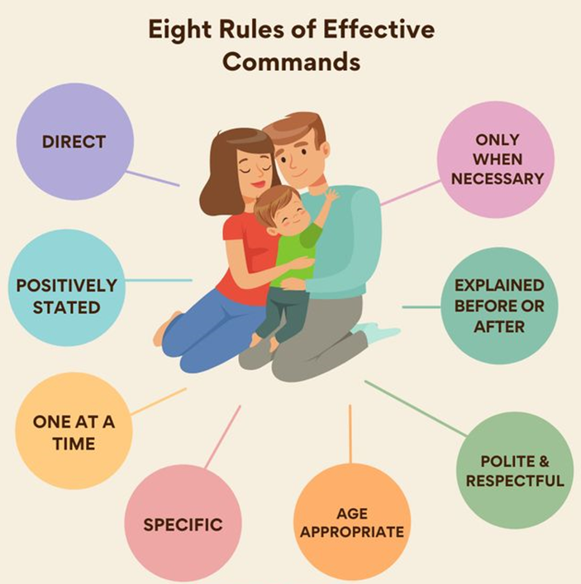
TOP TIPS
Give children alternatives and choices.
When – Then commands
Avoid question commands
Use clear logical consequences when necessary.
Consequences should be short term and immediate.
Praise the effort and process.
Firm Boundaries
Pick your battles
Be Consistent

Slide 27


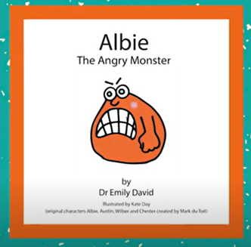
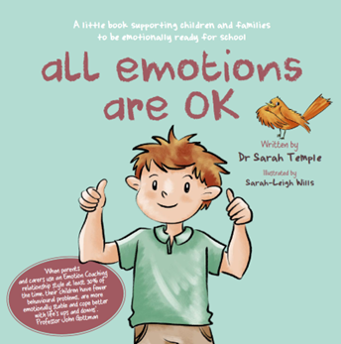
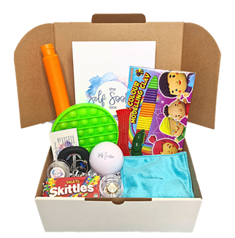
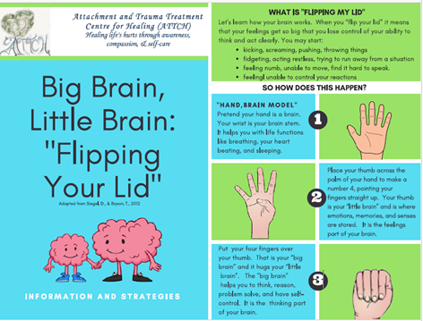
Helpful Resources

Slide 28


www.familylives.org.uk/ or Call 0808 800 2222
https://hampshirecamhs.nhs.uk/video/managing-challenging-behaviour/

Slide 29
If you need further help…
You can speak to your school’s Mental Health Lead for advice and support.
Or if needed a potential referral to the Mental Health Support Team.

Slide 30

Please ask any questions you have. There is no such thing as a silly question…

